Slide 1

RANSAC
数学计算机科学学院
丁新涛

Slide 2
RANSAC
RANSAC算法步骤：
抽样
建模
一致性检验
内点回归
预测

Slide 3
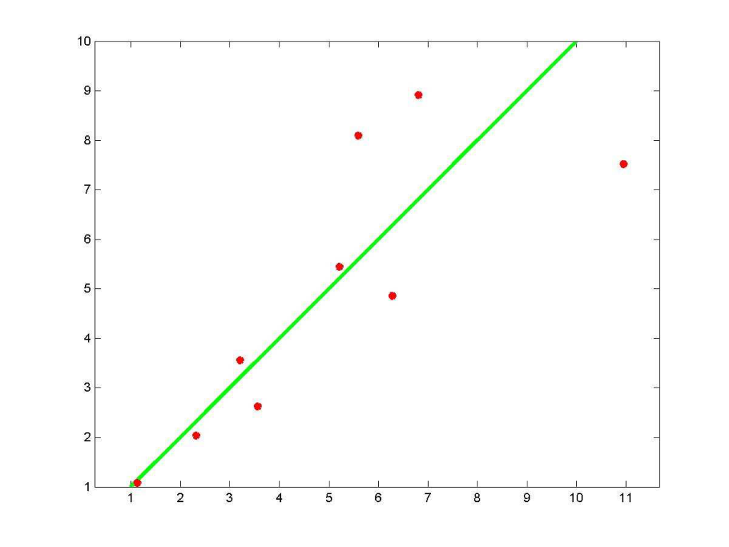
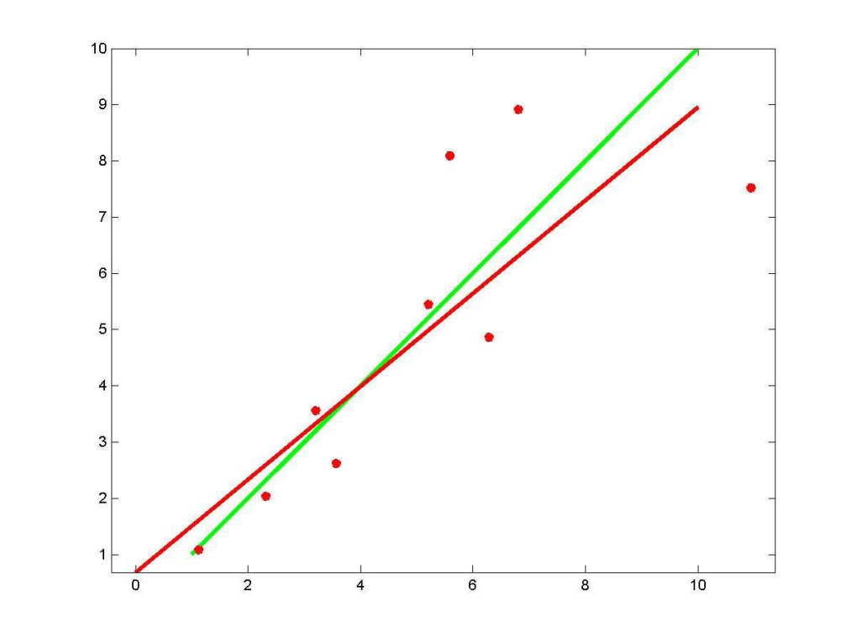
RANSAC
Least-Squares Example
Actual
Data
Fitted Data
*

Slide 4
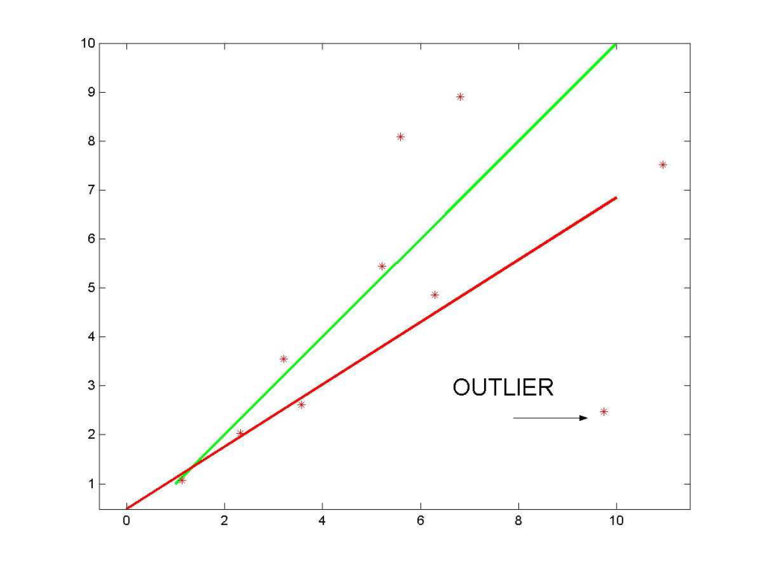
RANSAC
Least-Squares Example with Outlier
Actual
Data
Fitted Data
*

Slide 5
RANSAC
Robust Estimation Objectives
• Identify and eliminate all outliers
• Identify all “valid” sensor measurements
• “Optimally” assimilate all valid measurements to estimate the parameters of interest

Slide 6
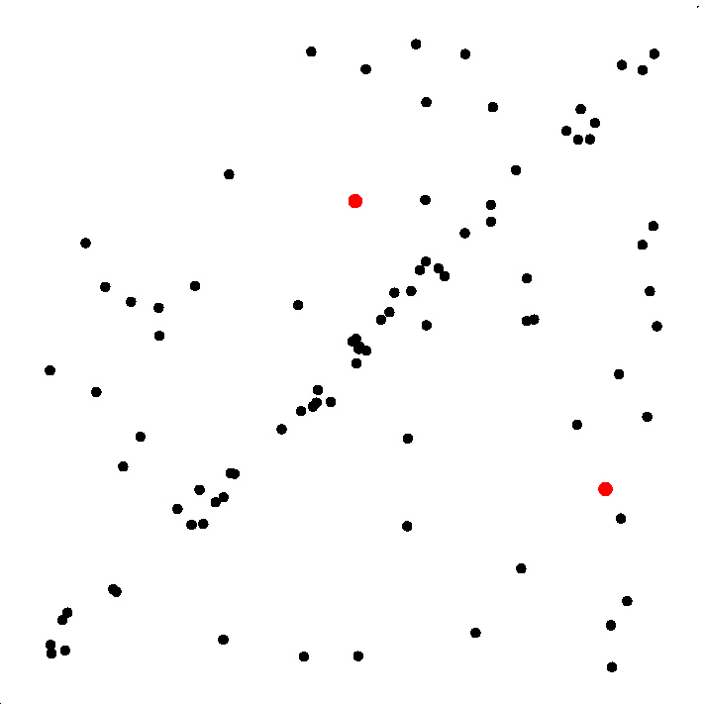
RANSAC
Step1
Select sample of m points at random

Slide 7
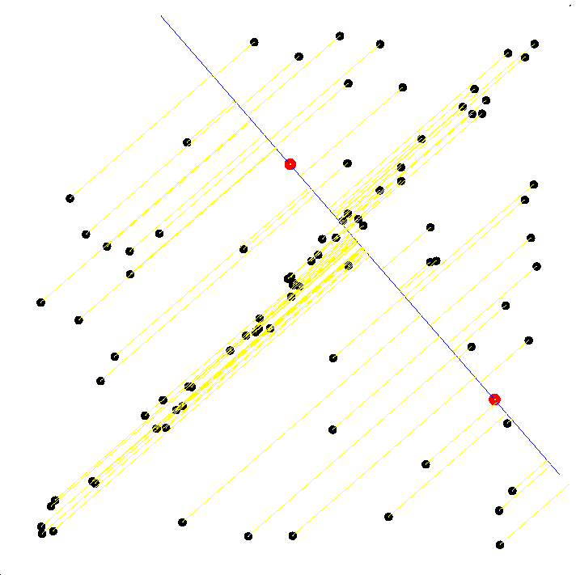
RANSAC
Step2
Select sample of m points at random
Calculate model parameters that fit the data in the sample
Calculate error function for each data point

Slide 8
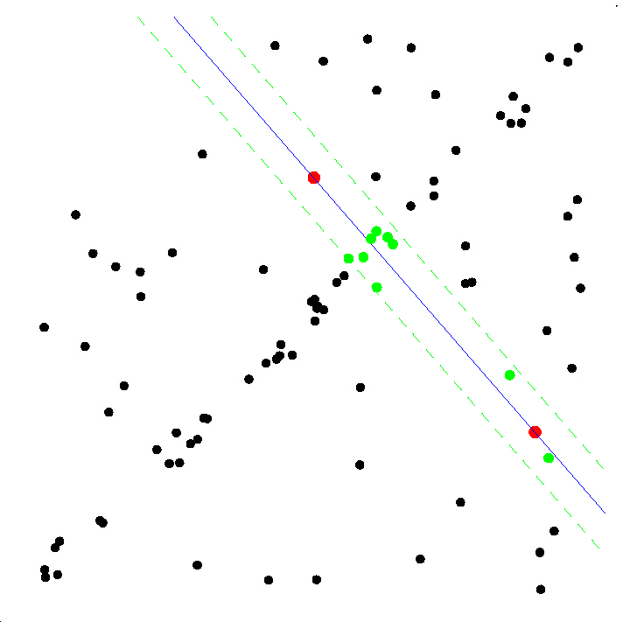
RANSAC
Step3
Select sample of m points at random
Calculate model parameters that fit the data in the sample
Calculate error function for each data point
Select data that support current hypothesis

Slide 9
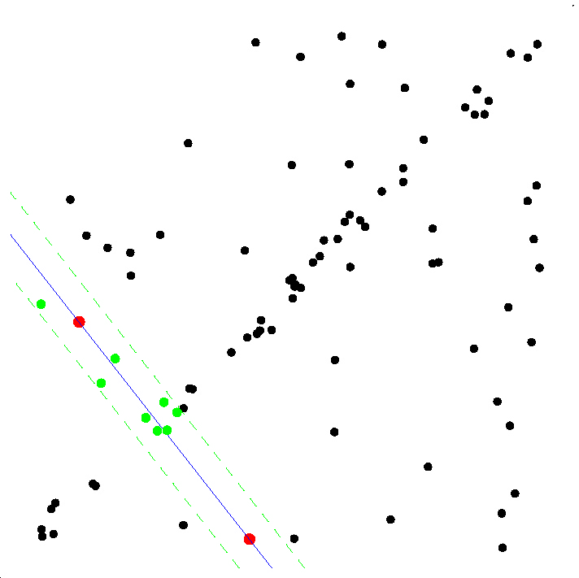
RANSAC
Step4
Select sample of m points at random
Calculate model parameters that fit the data in the sample
Calculate error function for each data point
Select data that support current hypothesis
Repeat sampling

Slide 10
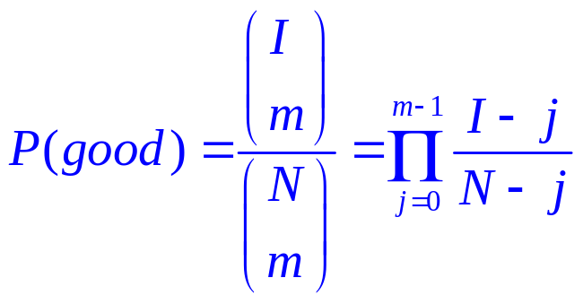
RANSAC
How Many Samples?
On average
N … number of point
I … number of inliers
m … size of the sample
mean time before the success
E(k) = 1 / P(good)

Slide 11




RANSAC
How Many Samples?
With confidence p

Slide 12
RANSAC
How Many Samples?
With confidence p
N … number of point
I … number of inliers
m … size of the sample
P(bad) = 1 – P(good)
P(bad k times) = (1 – P(good))^{k}

Slide 13
RANSAC
How Many Samples?
With confidence p
P(bad k times) = (1 – P(good))^{k} ≤ 1 - p
k log (1 – P(good)) ≤ log(1 – p)
k ≥ log(1 – p) / log (1 – P(good))

Slide 14
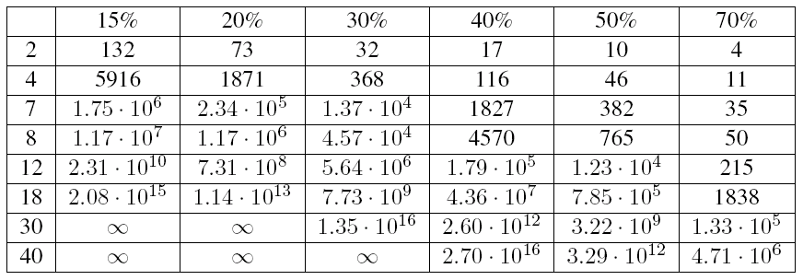
RANSAC
How Many Samples?
I / N [%]
Size of the sample m

Slide 15
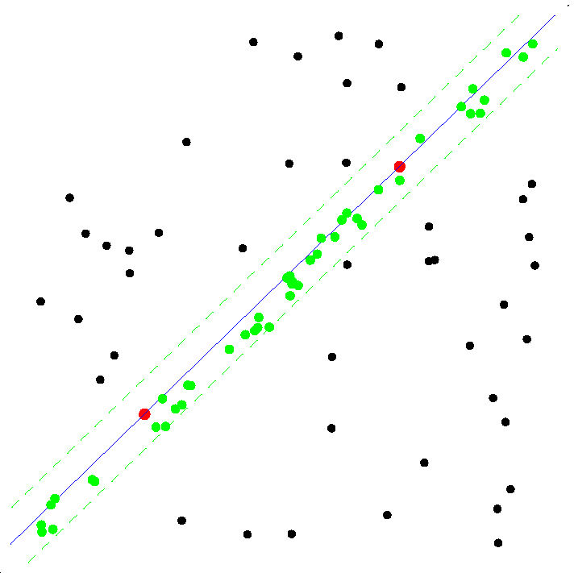
RANSAC
How Many Samples?
log(1 – p)
k =
log (1- )
I
I-1
N
N-1
k … number of samples drawn
N … number of data points
I … time to compute a single model
p … confidence in the
solution (.95)

Slide 16
RANSAC
RANSAC [Fischler, Bolles ’81]
In: 1) U = {x_{i}} set of data points, |U| = N
2) function f computes model parameters p given a sample S from U
3) the cost function for a single data point x
Out: p* that is the parameters of the model maximizing the cost function
k := 0
Repeat until P{better solution exists} < η (a function of C* and no. of steps k)
k := k + 1
I. Hypothesis
(1) select randomly set with a minimum sample size of the model
(2) compute parameters
II. Verification
(3) compute cost C_{k}
(4) if C* < C_{k} then C* := C_{k}, p* := p_{k}
end

Slide 17
RANSAC
案例实现

